Slide 1
Five Principle Of Management
PRESENTER’S NAME
INSTITUTION
COURSE
DATE

Slide 2

Introduction
For the third straight year, the American College of Healthcare Executives’ Top Concerns Facing Hospitals survey found that management challenges still rate as CEOs’ top concern. This includes:
Management issues,
patient protection,
efficiency issues,
staff shortages
It is not shocking that health-care CEOs deem these concerns to be among the most important they face considering healthcare complexity today.
None of these concerns will be addressed without dedication to the effective management of the healthcare system (Feller et al.,2017)
.
Notes:
For the third straight year, the American College of Healthcare Executives’ Top Concerns Facing Hospitals survey found that management challenges still rate as CEOs’ top concern. Simulatory mandates, patient protection, efficiency issues, and staff shortages have jockeyed for second and third positions, respectively, on the list since 2017. It is not shocking that CEOs deem these concerns to be among the most important they face considering healthcare complexity today. None of these concerns will be addressed without dedication to the effective management of the healthcare system (Feller et al.,2017)
.

Slide 3

Planning
The approach of health planning entails developing objectives and expectations for the future of an organization and building a roadmap to fulfill those objectives. In particular, in this sector, planning in healthcare has to take future shifts in:
government policies
technology advances
economic conditions into account.
Notes:
The approach of health planning entails developing objectives and expectations for the future of an organization and building a roadmap to fulfill those objectives. In particular, in this sector, preparing healthcare has to take future shifts in government policies, technology advances, and economic conditions into account, which can dramatically impact an organization’s activities.

Slide 4

Training for the unforeseen would help equip hospitals , clinics and private physicians as well as all healthcare institutions for what can be achieved.
From the financial aspect of a business to the structural decisions of the hospital or clinic.(Pineo, 2020), preparation is necessary.
Healthcare strategic plan provides for greater consistency in all facets of running a practice, no matter how large or small.
Notes:
The healthcare sector is continually evolving and progressing at a pace, unlike any other. Over the last few decades, it has been more and more essential to prepare for the future for every healthcare professional to be sustainable for years to come. Through training for the unexpected, hospitals, clinics (Pineo,2020), private practitioners, and other healthcare entities will be better prepared for whatever can come along down the track. From the financial side of operating an organization to structural decisions within the hospital or clinic, preparation is necessary. A hospital strategic strategy provides for greater consistency in all facets of running a practice, no matter how large or small.

Slide 5
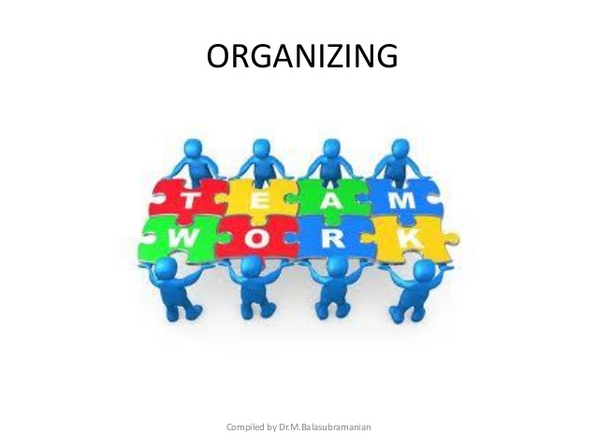
Organizing
Organizing and systemic issues related to healthcare system include:
Acquisitions of health-care properties
alliances with other health-care entities
departmental
organizational transformation as a whole.
This also involves healthcare practitioners problems Particularly:
relationships between doctors and hospitals.
Shortage of personnel
Efficiency of the system.
Notes:
Management and systemic issues related to companies include fusions, acquisitions, alliances with other entities, and departmental and organizational transformation as a whole. This involves doctoral problems – particularly relationships between doctors and hospitals. The operational challenge also consists of the need for management to ensure no shortage of personnel – especially in a high-speed hospital or changes with many patients.
The ultimate framework involves implementing policy, breakthrough improvement, and regular administration, connecting both components to notify each other. A standard management framework is where most employees coordinate their work in a hospital or healthcare framework and have three constants: frequent checks, problem-solving, and performance evaluations.

Slide 6

The framework involves
Implementing health-care policies
Check-ins in each health department
Performance reviews
Directing
Notes:
Check-ins are short one-on-one organizational meetings at the beginning of each shift between managers and their team members to discuss concerns, recognize where difficulties can arise, and seek changes. It is as much a resource preparation mentoring session that takes place in the workplace as in the boss’ office. The supervisors then interact similarly with their managers, who interact with their managers, who all adjust the same problems, driven partly by the company’s strategic needs.
The daily solution of problems is typically performed at regular unit huddles. A supervisor directs the team to define and then solve problems using the scientific approach as routine measures.
Performance reviews are a series of monthly cascade sessions that measure success in improving targets. These sessions start with area managers, who collaborate with their consultant staff and serve as advisors and a sounding committee. Next, the vice-president or managing director visits their director to identify concerns and provide assistance. And managers meet the CEO to ensure consistency in efficiency, safety, cost, and employee involvement with the few crucial change drivers .

Slide 7


Directing
Directing the health-care system refers to a method or strategy for
Training,
Direction,
Motivation,
Therapy,
Oversight,
Execution Of Operational Objectives.
Notes:
Directing the health-care system refers to a method or strategy for training, direction, motivation, therapy, oversight, and the execution of operational objectives. The process continues throughout the life of the company. It is a management process. Via direction, a superior connects and motivates his subordinates to work in the desired manner to accomplish the organization's goals. Such administrative roles, such as planning, organization, and hiring, are inefficient without guidance. This makes the health system effective.

Slide 8

The process continues throughout the life of the company. It is a management process. Via direction, a superior connects and motivates his subordinates to work in the desired manner to accomplish the organization's goals(Samson et al., 2020).
Such as administrative roles, such as planning, organization, and hiring, are inefficient without guidance. This makes the health system effective.
Directing in the health sector helps: taking intervention, incorporating staff efforts, encouraging means, encouraging progress, ensuring balance and cohesion, and maintaining coordination. This ensures productivity and positive patient outcome (Samson et al., 2020).
Notes:
Such administrative roles, such as planning, organization, and hiring, are inefficient without guidance. This makes the health system effective.
Directing in the health sector helps: taking intervention, incorporating staff efforts, encouraging means, encouraging progress, ensuring balance and cohesion, and maintaining coordination (Samson et al., 2020). .

Slide 9

Controlling
Control is a monitoring feature that helps to track failures to take correction steps.
This is done to:
Eliminate divergence from expectations from the health care system
Ensure that the health-care specified priorities are met accordingly.
According to current principles, control is a foreseeable operation; prior control principles were used mostly where faults were established.
Notes:
Control is a monitoring feature that helps to track failures to take correction steps. This is done to eliminate divergence from expectations and ensure that the organization's specified priorities are met accordingly. According to current principles, control is a foreseeable operation; prior control principles were used mostly where faults were established.

Slide 10

Controlling in health-care administration includes:
standardization of strategies
assessment of evidence based results
decision-making.
Notes:
Controlling in health-care administration includes standardization of strategies, assessment of real results, and decision-making.

Slide 11

Leading
Leading is another critical role of the health-care management process: Motivating workers to accomplish organization's objectives is the use of power.
Notes:
Leading is another critical role of the health-care management process: "Motivating workers to accomplish organization's objectives is the use of power."

Slide 12

Managers need to help workers accomplish the aims of their healthcare organization through :
Empowering health-care employees,
Positively influencing employees
efficient team development.
The leading process aids the health-care system in achieving its goals.
Notes:
Managers need to help workers accomplish the aims of their organization through : Empowering employees, employees influencing, and efficient team development.
The leading process aids the company in achieving its goals.

Slide 13
Conclusion
In summary, in health care system management includes
planning,
organization,
employee management,
administration,
governance
General organization management.
Managers thus should successfully manage the healthcare resources ensuring that the goals of the health-care facility are achieved.
Notes:
In summary, in health care system management includes planning, organization, employee management, administration, governance, and organization management. A manager thus successfully manages the resources of an organization ensuring that the goals of the health care organization are achieved.

Slide 14
References
Samson, D., Donnet, T., & Daft, R. L. (2020). Management. Cengage AU.
Feller, L., Fourie, J., Bouckaert, M., Khammissa, R. A. G., Ballyram, R., & Lemmer, J. (2017). Burning mouth syndrome: aetiopathogenesis and principles of management. Pain Research and Management, 2017.
Pineo, H. (2020). Towards healthy urbanism: inclusive, equitable and sustainable (THRIVES)–an urban design and planning framework from theory to praxis. Cities & health, 1-19.

